Slide 1


SALES EXPLORATORY DATA ANALYSIS AND PREDICTION

Slide 2
PROJECT OVERVIEW
The objective of this project was to leverage advanced data analytics and machine learning to optimize product strategy, pricing, and inventory management for Zara.
By examining a comprehensive dataset of approximately 20,000 product records, the analysis sought to uncover the hidden drivers of revenue and identify actionable opportunities for growth within the competitive fast-fashion landscape.
The foundation of this study was a dataset tailored for Exploratory Data Analysis (EDA) and predictive modeling. It encompassed rich product attributes including pricing, sales volume, seasonal categorization, promotional status, material composition, and country of origin.
To ensure the integrity of the analysis, the data underwent rigorous preprocessing, including the handling of missing values, the encoding of categorical variables such as "Season" and "Section" (Gender), and the scaling of numerical features to prepare them for algorithmic processing.
Using a multi-faceted methodological approach, the project employed several machine learning techniques to address specific business questions. Exploratory Data Analysis first established a baseline understanding of the market, revealing a right-skewed price distribution that underscores Zara’s identity as an affordability-first retailer, with a "sweet spot" for volume between $25 and $50.
Following this, a Random Forest Regressor was deployed to predict sales volume, identifying price and seasonality as critical variables. A Logistic Regression model was utilized to determine the probability of a product becoming a bestseller, isolating "Promotion" as the single strongest predictor of success.

Slide 3
DATA METHODOLOGY
To ensure high-quality insights, I implemented a rigorous data pipeline:
Data Cleaning: I scrutinized over 20,000 records. I handled missing values and converted each columns to their appropriate data.
Preprocessing: Transformed raw data by encoding categorical variables (Season, Material, Origin) and scaling
numerical features (Price, Volume) to prepare for algorithmic processing.
Validation: Implemented an 80/20 Train-Test split to ensure all models were tested on unseen data, preventing overfitting and ensuring real-world reliability.
Modeling Strategy
Random Forest: Used to predict sales volume based on non-linear price elasticity.
Logistic Regression: Used to identify "Promotion" as the #1 statistical driver of bestsellers.
TOOLS PYTHON:
Pandas for Data Cleaning
Numpy for Numerical Calculation Matplotlib and Seaborn for Visualization Scikit-Learn for Prediction

Slide 4
EXPLORATORY DATA ANALYSIS AND VISUALIZATION

Slide 5
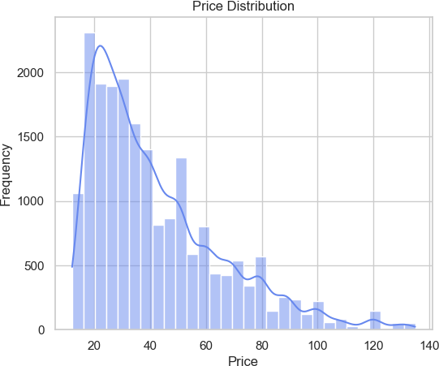
The price distribution is right-skewed, indicating that the majority of Zara's products are priced at the lower to mid-range, with a few
high-priced items extending the tail. This aligns with the fast-fashion model of affordability.

Slide 6
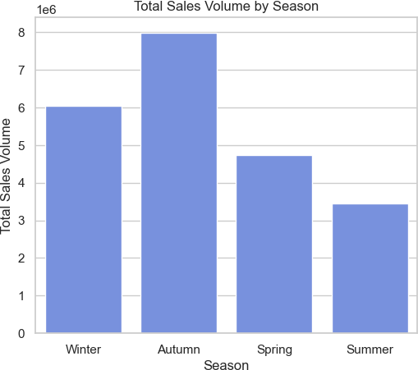
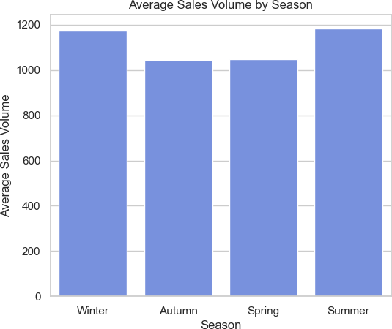
Total Sales Volume: Autumn is the highest volume season overall, driving nearly 8 million sales, followed by Winter. Winter is strong in both metrics, high total volume (6M) and high average sales per item (1,175), confirming it as a critical revenue period.
Average Sales Volume: Interestingly, while Summer has the lowest total sales (likely due to fewer products or shorter window), it has the highest average sales per product (1,185 units). This suggests that Summer items, when listed, perform very efficiently individually.

Slide 7
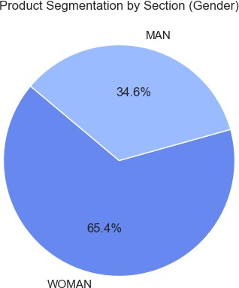
Gender-Based Segmentation
The count of products by section (MAN vs. WOMAN) shows the inventory balance. This reveals if the dataset (or Zara's strategy) leans heavily towards one demographic - Woman

Slide 8
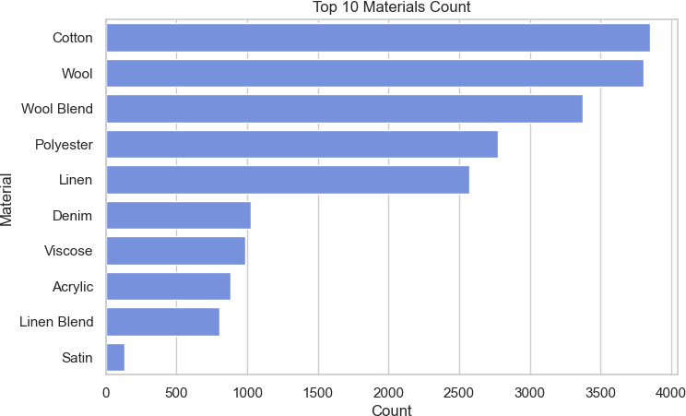

Slide 9
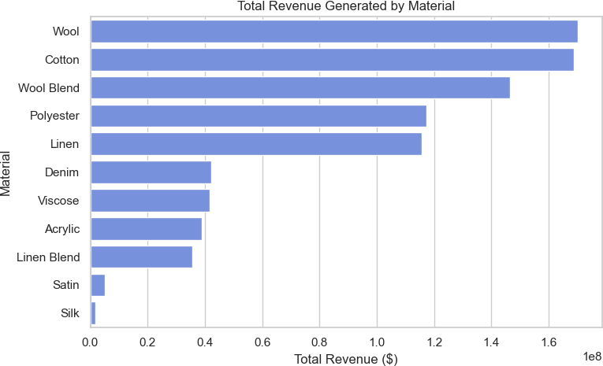
Profitability by Fabric Type
Using "Revenue" (Price X Sales Volume) as a proxy for profitability.

Slide 10
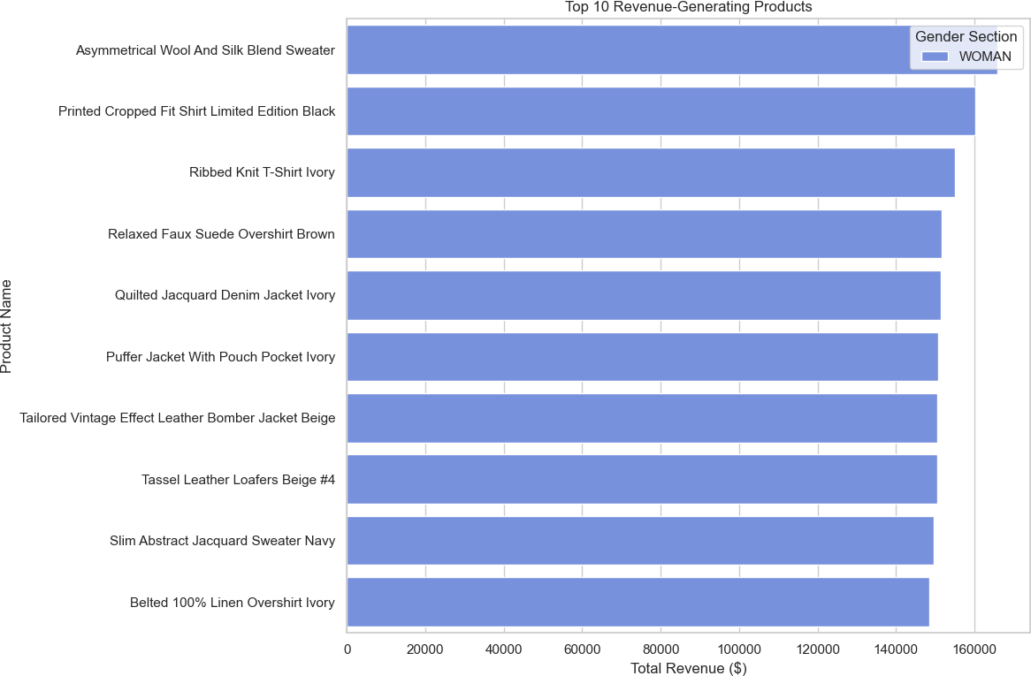

Slide 11
Product Name | Price ($) | Sales Volume | Total Revenue ($) | Section (Gender) | Season
Asymmetrical Wool And Silk Blend Sweater | 115.95 | 1,431 | 165,924.45 | WOMAN | Winter
Printed Cropped Fit Shirt Limited Edition Black | 117.99 | 1,359 | 160,348.41 | WOMAN | Summer
Ribbed Knit T-Shirt Ivory | 109.95 | 1,410 | 155,029.50 | WOMAN | Summer
Relaxed Faux Suede Overshirt Brown | 111.99 | 1,355 | 151,746.45 | WOMAN | Summer
Quilted Jacquard Denim Jacket Ivory | 115.95 | 1,307 | 151,546.65 | WOMAN | Summer
Puffer Jacket With Pouch Pocket Ivory | 106.99 | 1,410 | 150,855.90 | WOMAN | Winter
Tailored Vintage Effect Leather Bomber Jacket Beige | 113.95 | 1,322 | 150,641.90 | WOMAN | Winter
Tassel Leather Loafers Beige #4 | 119.99 | 1,254 | 150,467.46 | WOMAN | Winter
Slim Abstract Jacquard Sweater Navy | 114.99 | 1,301 | 149,601.99 | WOMAN | Summer
Belted 100% Linen Overshirt Ivory | 99.95 | 1,486 | 148,525.70 | WOMAN | Summer

Slide 12
Key Insights
Dominance of the WOMAN Section: Every single product in the top 10 revenue list is from the WOMAN section. This
strongly indicates that this demographic is the primary driver of high-value sales.
High Price Points Work: Unlike the "Best Sellers by Volume" list (which were mostly $20-$30 items), this "Revenue" list is dominated by items priced around $100 - $120. These are premium items like wool blends, leather, and elaborate jackets.
Seasonality is Balanced: The list is split fairly evenly between Summer (light jackets, linen, printed shirts) and Winter (sweaters, puffer jackets, leather). This shows that customers are willing to pay a premium for seasonal "statement pieces" all year round.
Material Matters: Notice the materials implied in the names: "Wool And Silk", "Leather", "Linen", "Jacquard". These
premium materials justify the higher price point and still achieve high sales volumes (over 1,200 units each).

Slide 13
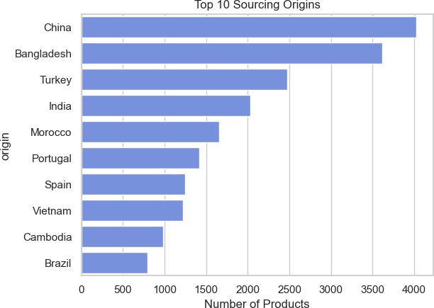

Slide 14
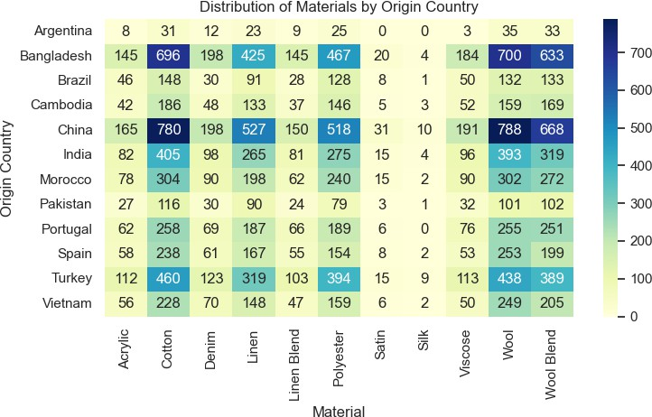

Slide 15
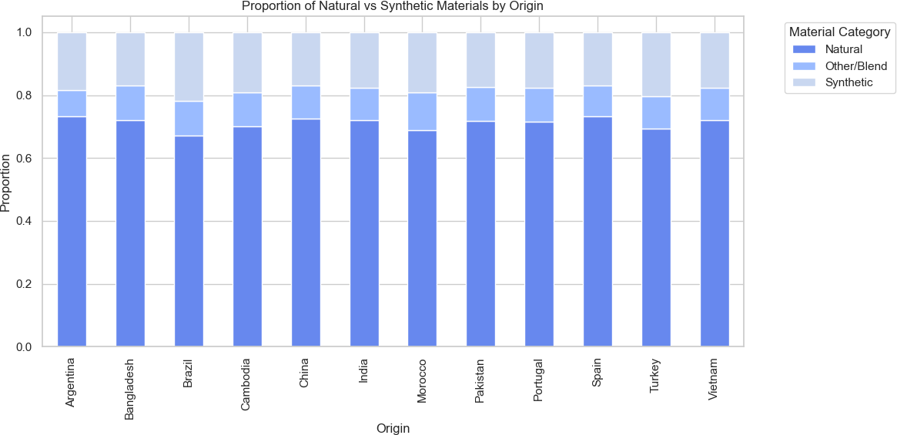

Slide 16
PREDICTIONS

Slide 17
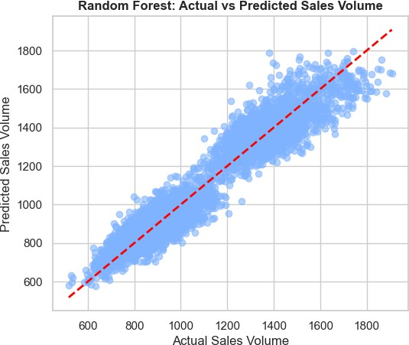
Using Random Forest Regressor to Predict Sales Volume For New Product
The performance of the model created was checked
==== Model Performance==== R2 Score :0.9214
MAE :63.6403
MSE :6633.6229
RMSE :81.4471
The Model Was Used To Predict Sales Volume Of A New Product With The Following Details.
Price: 50 Section: Woman Season: Winter Material: Cotton
Origin: Bangladesh
Predicted Sales Volume for new product: 949.24

Slide 18
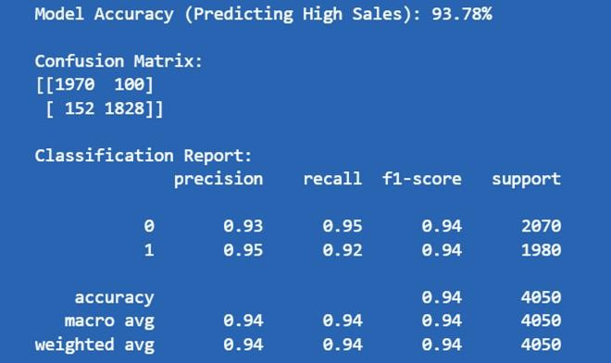
Using Logistics Regression in Predicting "High Sales" Products

Slide 19
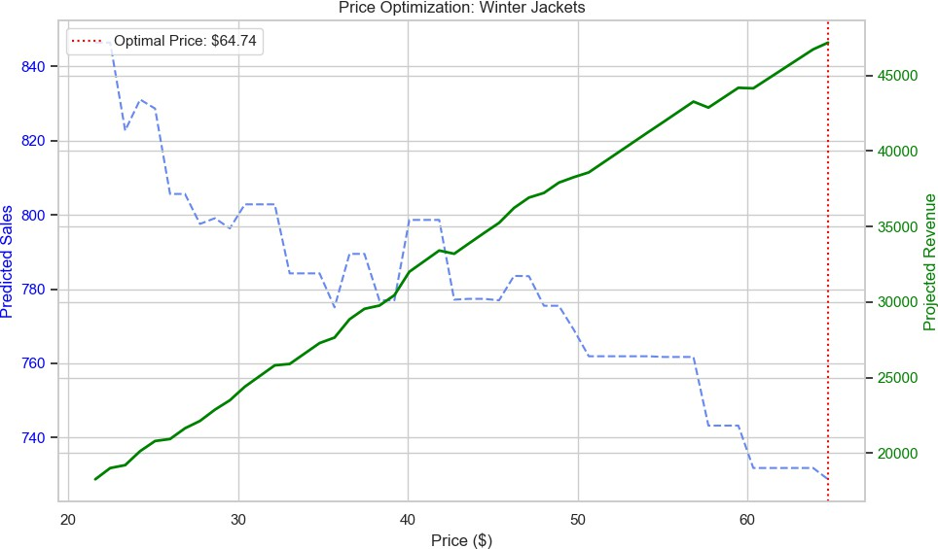

Slide 20
The Price Optimization analysis for "Winter Jackets" segment
Analysis of the Results:
The chart visualizes the trade-off between Price (x-axis), Sales Volume (blue dashed line), and Revenue (green solid line).
Sales Volume Trend: As expected, as the price increases, the predicted sales volume decreases (blue line slopes downward).
Revenue Sweet Spot: The green curve shows the projected revenue. It rises initially as price increases (gaining more
per unit) but eventually drops when the volume loss outweighs the price increase.
Optimal Price Point: The model suggests an optimal price of approximately $64.74.
Current Average Price: The data indicates the current average price for this segment is roughly $77.87 (derived from the chart range center).
Insight: The model suggests that lowering the price to around $65 could potentially maximize total revenue by
driving significantly higher volume, despite the lower margin per unit.
Projected Max Revenue: The model suggests a projected maximum revenue of approximately $47,180.18
Recommendation: Consider testing a price point near $64.99 for Winter Jackets to see if the real-world volume uplift
matches the model's prediction.

Slide 21


